Slide 1
Mobile and Web BASED Human Task Management
AndreW, Grant, KEVIN, Sergio

Slide 2

Android Application
Human task management client
Tasks stored and managed locally
Task can be uploaded to task management web server

Slide 3
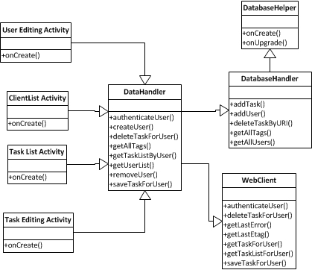
Main Classes

Slide 4
Web Queries
GetUserTaskList( URI user )
Request: HTTP GET
Response:
Body: XML object with task URIs
GetTaskDetails( URI task )
Request : HTTP GET
Header: resource ETAG
Response :
Header: resource ETAG
Body: XML object with task data
DeleteTask ( URI task )
Request : HTTP DELETE
Response :
Code: 20?

Slide 5
Web Queries
CreateTask( Task t )
Request: HTTP POST
Body: XML object with task data
Response:
Header: new task URI
EditTask( Task t, URI taskURI )
Request : HTTP PUT
Header: resource ETAG
Response :
Header: resource ETAG

Slide 6
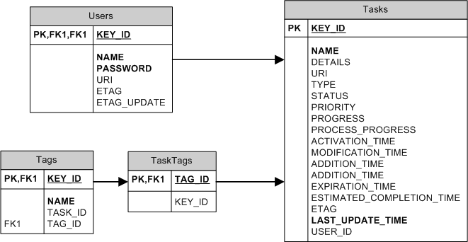
Local Cache

Slide 7
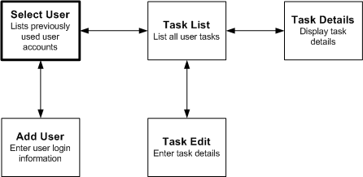
Application Activities

Slide 8
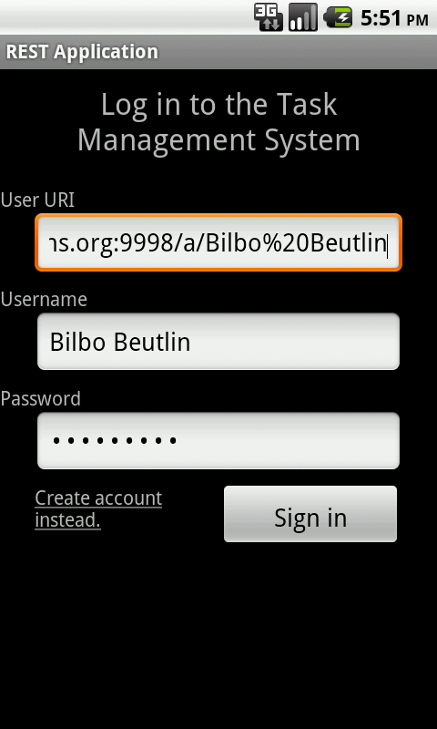
Login

Slide 9
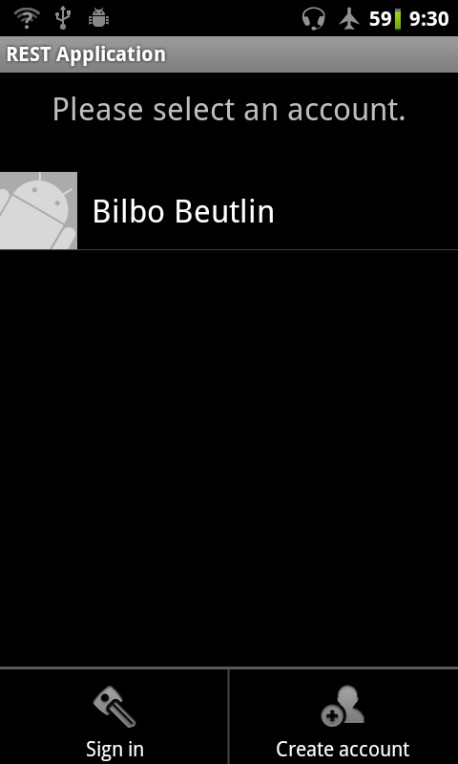
Select user

Slide 10
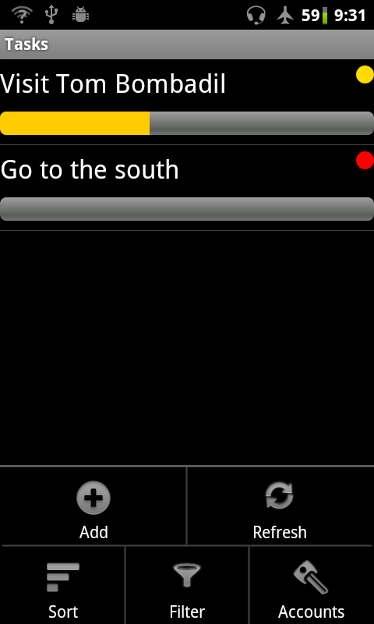
Task List

Slide 11
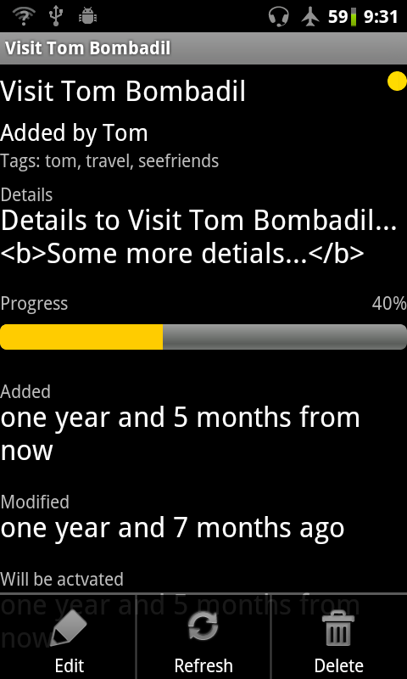
Task Details

Slide 12
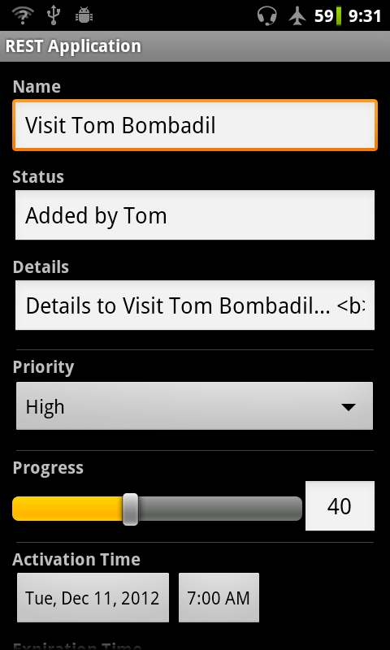
Task Editing

